Slide 1
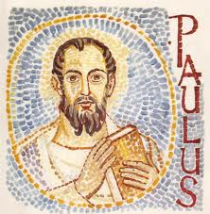
I Wonder Who Saint Paul Was ?

Slide 2
St Paul’s Jewish name was Saul.
Tarsus
He was a Roman Citizen who came from the town of Tarsus

Slide 3
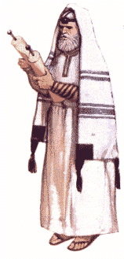
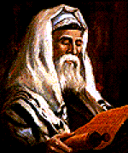
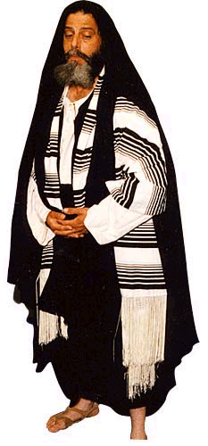
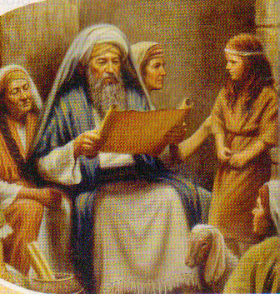
He knew the rules and customs of his religion… He was a Pharisee

Slide 4
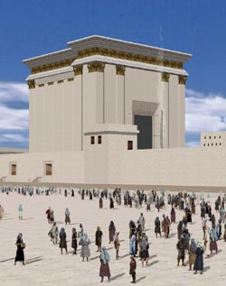
He was so clever at his studies he was sent to Jerusalem to learn his Faith even more… as a young man.

Slide 5
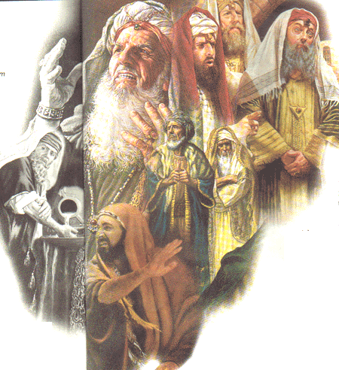
When he was grown up he worked for the Religious Leaders of the Time

Slide 6
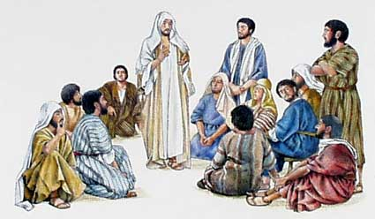
They wanted to get rid of the Jesus Followers (the Early Jewish Christians) ‘the followers of the Way’

Slide 7
It was Saul’s Job to Find - Imprison and Punish these Christ ians…

Slide 8
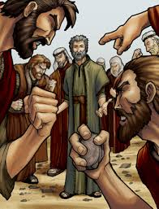
He held the cloaks at the Execution of St Stephen (the First Martyr)

Slide 9
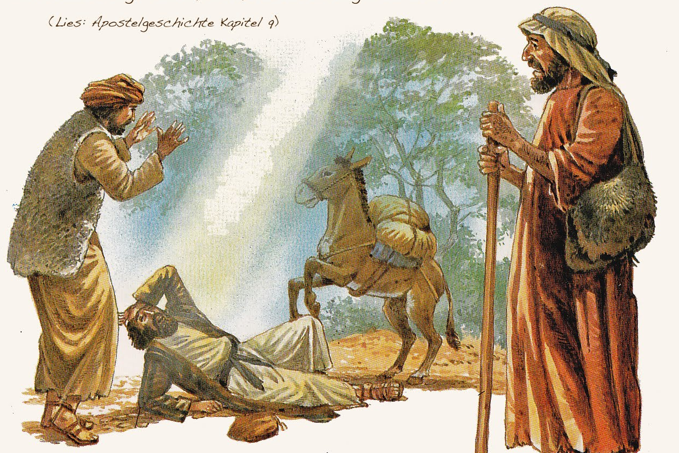
The book of ACTS tells us that Paul was travelling to Damascus to persecute more Christians …
When…

Slide 10
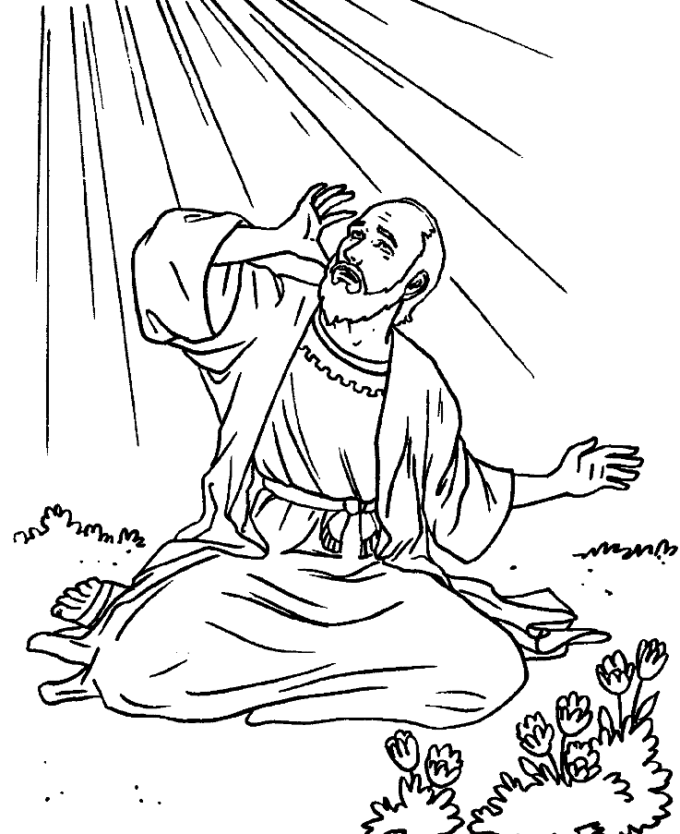
Paul had a Vision of Jesus
“Saul, Saul why do you persecute Me?”
“Who are you Lord?”
“I am Jesus who you persecute…”

Slide 11
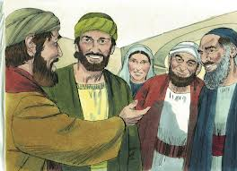
For a time he learned more about Jesus and what it meant to be a follower…

Slide 12
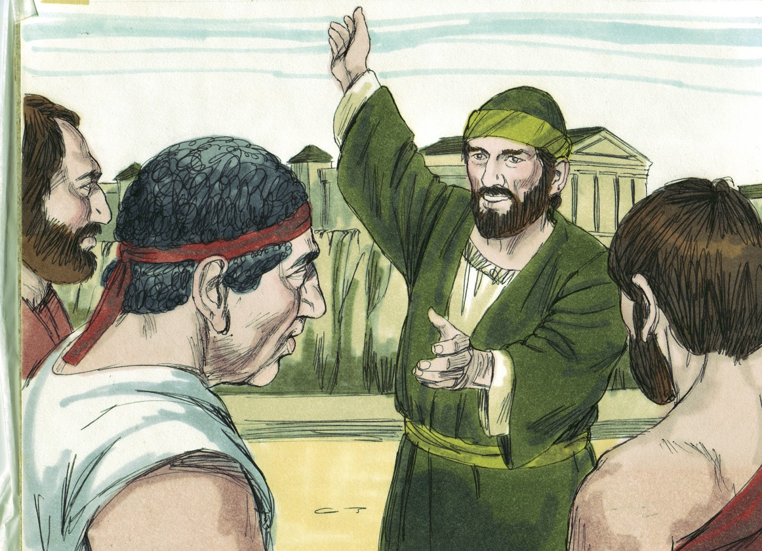
Then he became a Missionary for Belief in Jesus

Slide 13
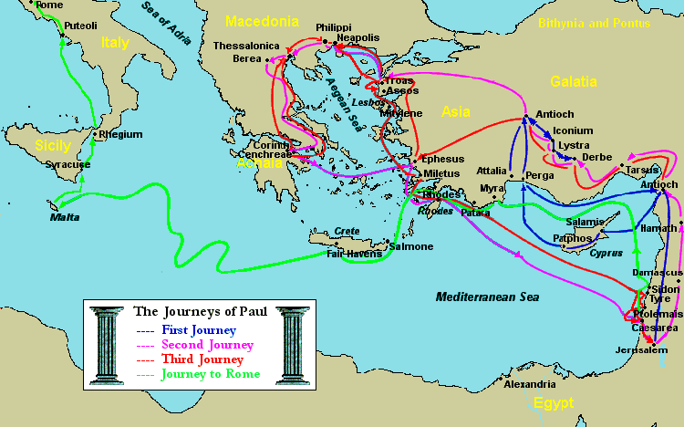
He travelled over Sea and Land

Slide 14
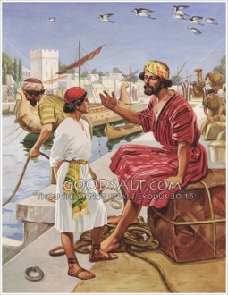
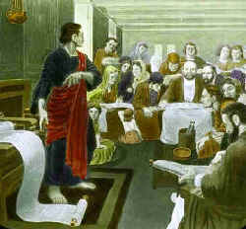
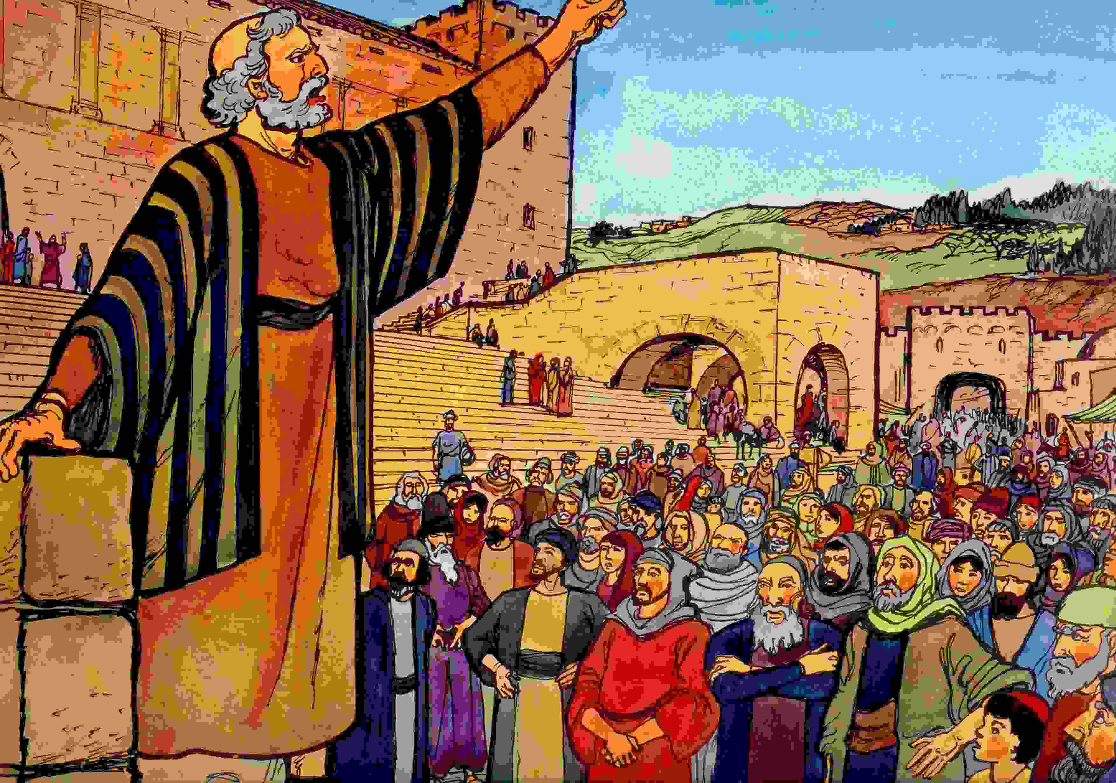
He started Christian Communities

Slide 15
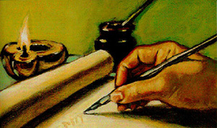
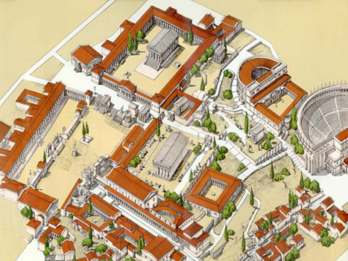
Wrote Letters to Christian Communities
Paul’s Letter to Corinth
His Letters encouraged Christians to follow Jesus no matter what the hardships.
Or he wrote to explain or decide on issues that were worrying the Early Christian Communities.

Slide 16
Paul believed strongly about these ideas:
Jesus was the Messiah because of his death and resurrection.
There was no longer separation amongst people-All were equal before God: Jew/Gentile; Men /Women; Master /Slave. Once you were baptised you were a son or daughter of God.
Gentile Christians didn’t have to become Jews before they became a Jesus Follower.
A person having the Spirit meant they were accepted by God.
Christian Masters had to treat their Christian slaves like brothers or sisters.
Being saved was a free gift from God –Jesus has begun a New Way.
Christians must act to make the love of Jesus real in the world.
He is the first to describe the message as
“Evangeleon”- Greek for Good News of Jesus Christ”

Slide 17
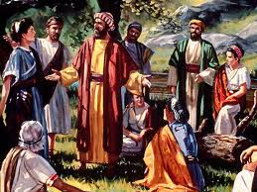
Paul’s Letter s were written and circulated Before the Gospels were Written.

Slide 18
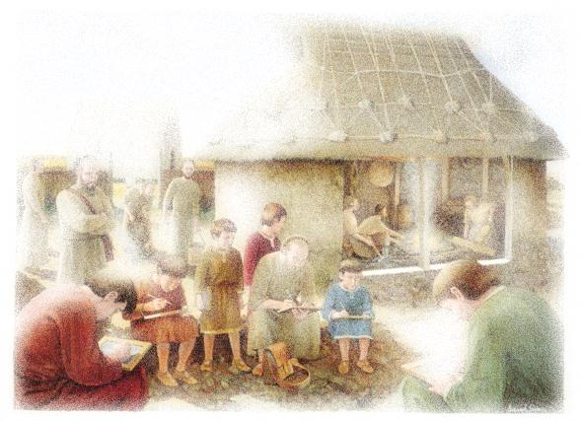
Paul had many friends who became leaders in the Churches…
Barnabas
James
Peter
Priscilla
Timothy
Silas
Mark-John
Stephanus, Fortunatus and Achaicus
Phoebe
Gaius & Erastus
Aquila
Andronicus & Junias

Slide 19
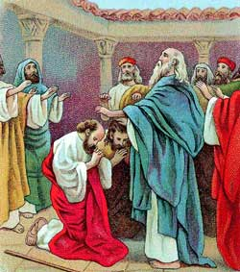
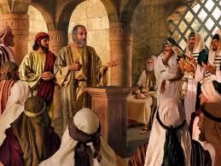
He was very successful among Gentile Believers…
But there were still Jews who were attracted to Jesus’ Way

Slide 20
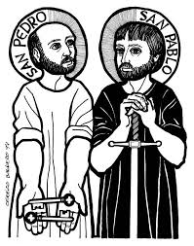
Peter and Paul were friends who were chosen by God to share the ‘Good News’

Slide 21
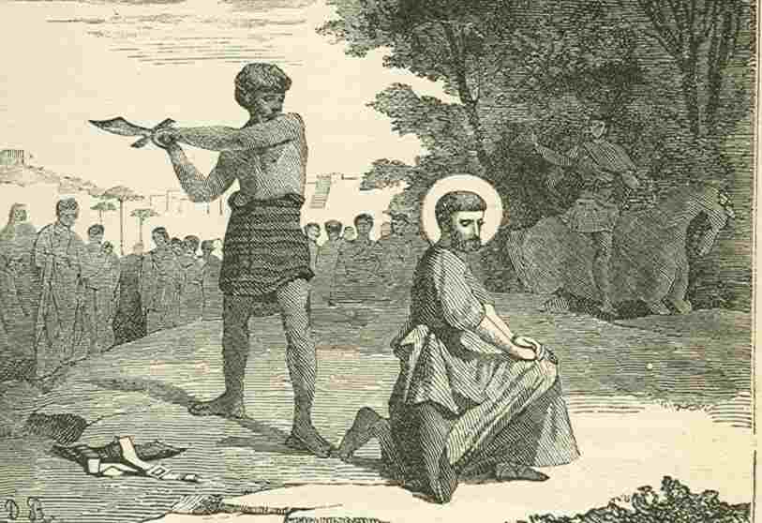
Even to the end St Paul would not deny his faith in the Risen Jesus

Slide 22
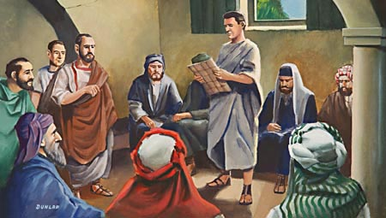
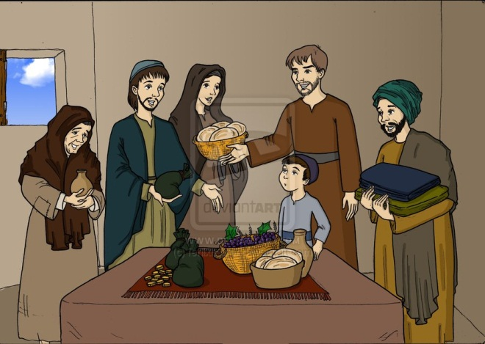
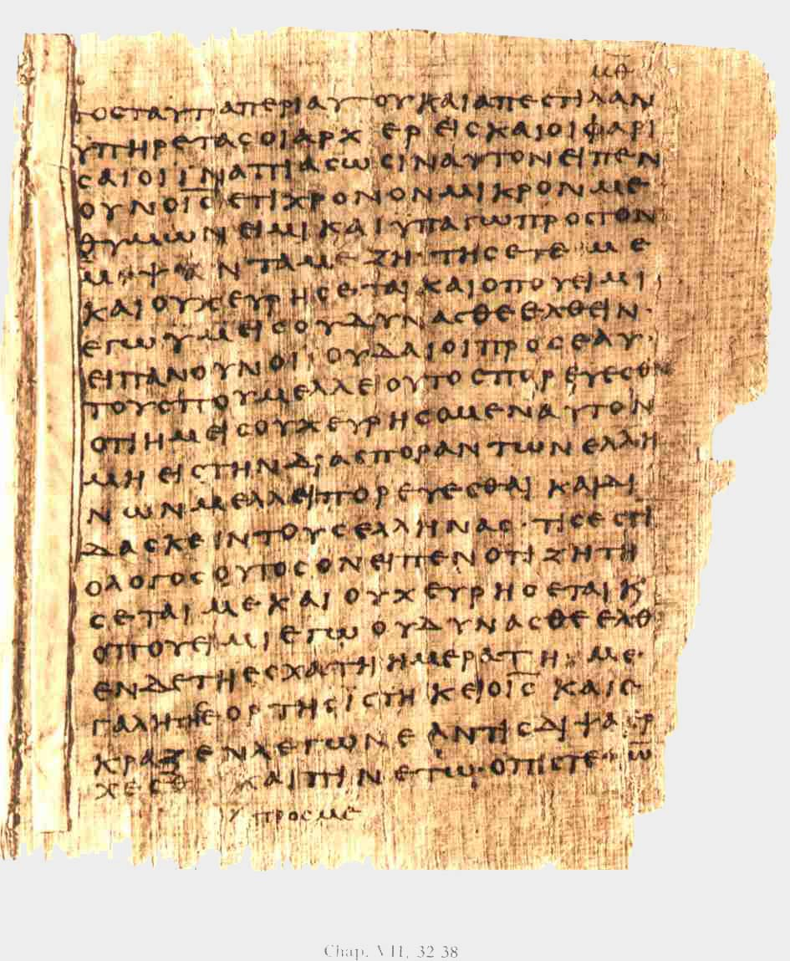
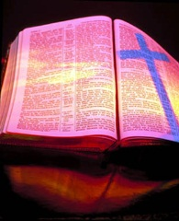
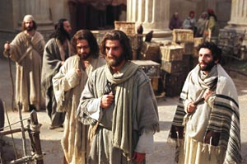
St Paul was a Christian Hero and his story and letters forms much of our Christian Scriptures

