Slide 1
Persuasive Texts

Slide 2
Learning Outcomes:
To identify some features of a persuasive text.
Success Criteria:
Identify some features of a persuasive text on a linoit and identify the structure of the text.

Slide 3
Ethos, Logos, Pathos
https://www.youtube.com/watch?v=x4tTugqBkJU

Slide 4
Example 1

Slide 5
Example 2

Slide 6
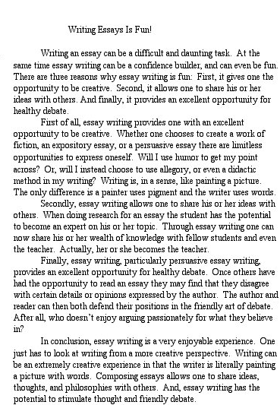
Example 3

Slide 7
What are the main features of a persuasive text?
Use the linoit forum to post 3 of your ideas

Slide 8
See the features in a text
http://mrcrammond.com/Writing/writingfun.swf

Slide 9
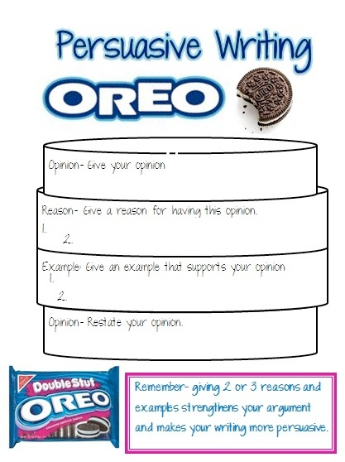
How should a persuasive text be structured?

